Slide 1
Objectives
In this session, you will learn to:
  Understand the double entry system of accounts
  Understand financial statements
  Identify the basic and advanced features of Tally.ERP 9
  Identify the key components of Tally.ERP 9
Notes:
Share the session objectives with the students.

Slide 2
Understanding the Double Entry System of Accounts
Trial balance:
  Is a list of the balances of all ledger accounts.
  Is prepared after:
    Making all the adjustment entries in the journal.
    Posing to the journal entries to the ledger.
    Balancing the ledger accounts.
  Is the sum of balances of all real, personal, and nominal accounts.
  Has columns for:
    Account name
    Debit balance
    Credit balance
Notes:
Share the session objectives with the students.

Slide 3
Understanding Financial Statements
A financial statement:
  Is a report prepared from the accounting records of a company to find the financial performance and status of a business for a specific period.
  Includes the following:
    Profit and loss account
    Balance sheet
    Cash-flow statement
The profit and loss account is divided into:
  Trading account
  Profit and loss account
Notes:
Share the session objectives with the students.

Slide 4
Understanding Financial Statements (Contd.)
The profit and loss statement is classified in two levels:
  Gross Profit, which is calculated as:
    Gross Profit = Net Sales – Cost of Sales
  Net profit, which is calculated as:
    Net Profit = (Gross Profit + Other Income) – (Selling and Administrative Expenses + Depreciation + Interest + Taxes + Other Expenses)
Notes:
Share the session objectives with the students.

Slide 5
Identifying the Basic and Advanced Features of Tally.ERP 9
Tally.ERP 9 is an accounting software that undertakes accounting in a simple way.
Tally.ERP 9:
  Is a leading accounting package.
  Has no accounting codes.
  Is a complete business solution.
  Can be integrated/non integrated accounting and inventory
  Is flexible and easy to use.
  Is speedy.
  Allows to maintain multiple companies.
  Provides unlimited levels of classification and grouping capabilities.
Notes:
Share the session objectives with the students.

Slide 6
Identifying the Basic and Advanced Features of Tally.ERP 9 (Contd.)
  Has concurrent multilingual flexibility.
  Has real-time processing.
  Is versatile.
  Has multi-platform availability.
  Provides online help.
  Offers editor’s edition.
Notes:
Share the session objectives with the students.

Slide 7
Identifying the Basic and Advanced Features of Tally.ERP 9 (Contd.)
The technological advantages of Tally.ERP 9 are:
  Simple and rapid installation
  Unlimited multi-user support
  Internal backup/restore
  Data reliability
  User-defined security levels
  Data security
  Tally audit
  TallyVault
  Removal of data into separate company
  Multi-directory for company management
  Import/Export of data
  Tally Synchronization
Notes:
Share the session objectives with the students.

Slide 8
Identifying the Basic and Advanced Features of Tally.ERP 9 (Contd.)
  Graphical analysis of data
  ODBC compliance
  Protocol support
  Direct web browser access
  Ability to preview and publish reports and documents on the internet
  E-mail facility
  Multilingual facility
  Point of Sale (POS)
  Tally.NET
  Remote Access
  Control Centre
  Support Centre
Notes:
Share the session objectives with the students.

Slide 9
Identifying the Basic and Advanced Features of Tally.ERP 9 (Contd.)
POS:
  Can be a retail outlet, a check out counter in a shop, or any other location where a sales transaction takes place.
  Is a computerized cash register, which:
    Adds up the sales totals
    Calculates the balance to be returned to buyer
    Automatically adjusts the inventory level to reflect the quantity sold
  Requires the equipments such as cash registers, card readers, and bar-code scanners to work effectively.
Notes:
Share the session objectives with the students.

Slide 10
Identifying the Basic and Advanced Features of Tally.ERP 9 (Contd.)
Payroll functionality in Tally.ERP 9:
  Allows to design and implement salary structures ranging from simple to complex.
  Can be automated and directly integrated with main stream accounting applications.
Configurable payroll formats can be used for:
  Payslip printing
  Flexible salary/wage
  Attendance, leave, and overtime registers
  Gratuity and Expat reports
  Statutory Payroll Forms and Reports
Notes:
Share the session objectives with the students.

Slide 11
Identifying the Basic and Advanced Features of Tally.ERP 9 (Contd.)
The features pertaining to duties and taxes are:
  Statutory reporting capability for:
    Value Added Tax (Vat)
    Composite Vat
    Central Sales Tax (CST)
    Tax Deducted at Source (TDS)
    Service tax (ST)
    Tax Collected at Source (TCS)
    Fringe Benefit Tax (FBT)
  State-specifc statutory VAT returns and Annexures
  CST related reports
  Returns and challans for Service Tax
  TCS reports with e-TCS capability for printing TCS certificates/challan
Notes:
Share the session objectives with the students.

Slide 12
Identifying the Basic and Advanced Features of Tally.ERP 9 (Contd.)
  Composition Monthly Vat Return
  Quarterly Return: Form II, in the case of Excise Dealer
  Periodic FBT Challans and Returns
Notes:
Share the session objectives with the students.

Slide 13
Identifying the Key Components of Tally.ERP 9
The screen components of Tally.ERP 9 are:
  Title bar
  Horizontal bar
  Close button
  Gateway of Tally
  Buttons toolbar
  Calculator Area
  Info Panel
Notes:
Share the session objectives with the students.

Slide 14
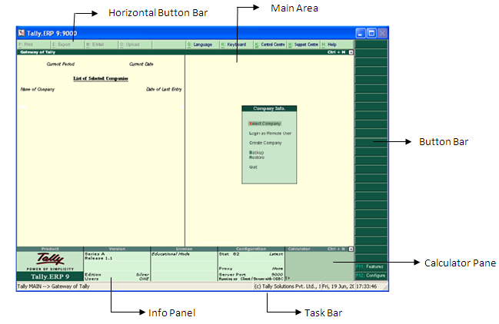
Identifying the Key Components of Tally.ERP 9 (Contd.)
The following figure shows the Tally.ERP start-up screen.
Notes:
Share the session objectives with the students.

Slide 15
Identifying the Key Components of Tally.ERP 9 (Contd.)
    The following figure shows the mouse/keyboard conventions to be followed while working with Tally.ERP 9.
To | Action
Click | Press the left mouse button
Double-Click | Press and release the left louse button twice, without moving the mouse pointer off the item.
Choose | Position the mouse pointer on the item and click the left mouse button.
Select | Position the mouse pointer on the item and double click the left mouse button.
Press | Use the keys on the keyboard in the combination shown.

Slide 16

Identifying the Key Components of Tally.ERP 9 (Contd.)
Notes:
Share the session objectives with the students.

Slide 17
Summary
In this session, you learned that:
  Trial balance is a list of the balances of all ledger accounts.
  Trial balance is the sum of balances of all real, personal, and nominal accounts.
  A financial statement is a report prepared from the accounting records of a company to find the financial performance and status of a business for a specific period.
  Tally.ERP 9 is an accounting software that undertakes accounting in a simple and natural way.
  POS can be a retail outlet, a check out counter in a shop, or any other location where a sales transaction takes place.
  Salary structures ranging from simple to complex can be designed and implemented in Tally.ERP 9.

Slide 18
Summary (Contd.)
  The features pertaining to duties and taxes are:
    Statutory reporting capability for Value Added Tax (Vat), Composite Vat, Central Sales Tax (CST), Tax Deducted at Source (TDS), Service tax (ST), Tax Collected at Source (TCS), Fringe Benefit Tax (FBT)
    State-specifc statutory VAT returns and Annexures
    CST related reports
    Returns and challans for Service Tax
    TCS reports with e-TCS capability for printing TCS certificates/challan
    Composition Monthly Vat Return
    Quarterly Return: Form II, in the case of Excise Dealer
    Periodic FBT Challans and Returns

Slide 19
Summary (Contd.)
  The screen components of Tally.ERP 9 are:
    Title bar
    Horizontal bar
    Close button
    Gateway of Tally
    Buttons toolbar
    Calculator Area
    Info Panel

